Slide 1

Data Structures
Lecture 13: Heaps

Slide 2

Heaps
A heap orders its nodes, but in a way different from a binary search tree. Unlike binary search trees, heaps can have duplicate values.
A complete tree is a max heap if
   The value in the root is the largest of the tree
   Every subtree is also a max heap
A complete tree is a min heap if
   The value in the root is the smallest of the tree
   Every subtree is also a min heap

Slide 3
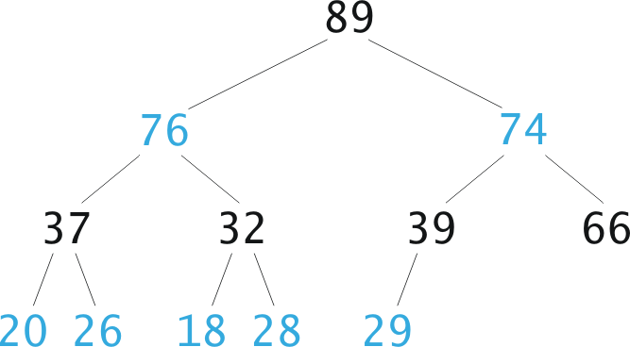
Max Heap - Example
Max heap

Slide 4
Min Heap - Example
Min heap
20
25
30
40
45
32
33
42
44
46
47
50

Slide 5
Inserting an Item into a Heap (Algorithm)
Insert the item in the next position across the bottom of the complete tree: preserve completeness
Restore “heap-ness”:
  while new item not root and > parent
  swap new item with parent
80
74
80
6
66
80

Slide 6
Removing from a Heap (Algorithm)
Removing an item is always from the top:
  Remove the root (maximum element):
    Leaves a “hole”:
  Fill the “hole” with the last item (lower right-hand) L
    Preserve completeness
  Swap L with largest child, as necessary
    Restore “heap-ness”
80
66
89
66
80
74
74
80
66
6
66
80

Slide 7
Implementing a Heap
Since heaps are complete binary trees, the most efficient way to implement them is using vectors.
11
0
The root is at index 0
8
1
7
2
The left child of a node at index p is:
2
3
5
5
4
4
5
2p + 1
The right child of a node at index p is:
0
1
2
3
4
5
2p + 2
11
8
7
2
5
4
The parent of a child at index c is: (c-1)/2

Slide 8
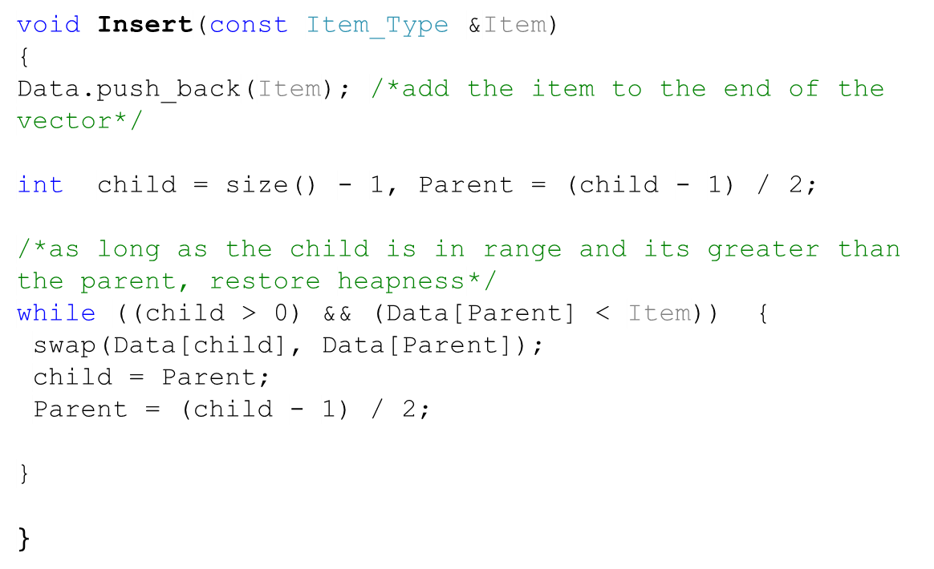
Inserting an item into a heap (Code)
80
80
74
6
80
66
Parent
Parent
Parent
74
80
0 | 1 | 2 | 3 | 4 | 5 | 6 | 7 | 8 | 9 | 10 | 11 | 12 | 13
89 | 76 | 74 | 37 | 32 | 39 | 66 | 20 | 26 | 18 | 28 | 29 | 6
80
66
80

Slide 9

Task
Show the max heap that would be used to store the words: this, is, the, house, that, jack, built, assuming they are inserted in that sequence.
Draw the heap as a vector.
[0] | this
[1] | that
[2] | the
[3] | house
[4] | is
[5] | jack
[6] | built
this
that
is
the
that
house
is
jack
built

Slide 10
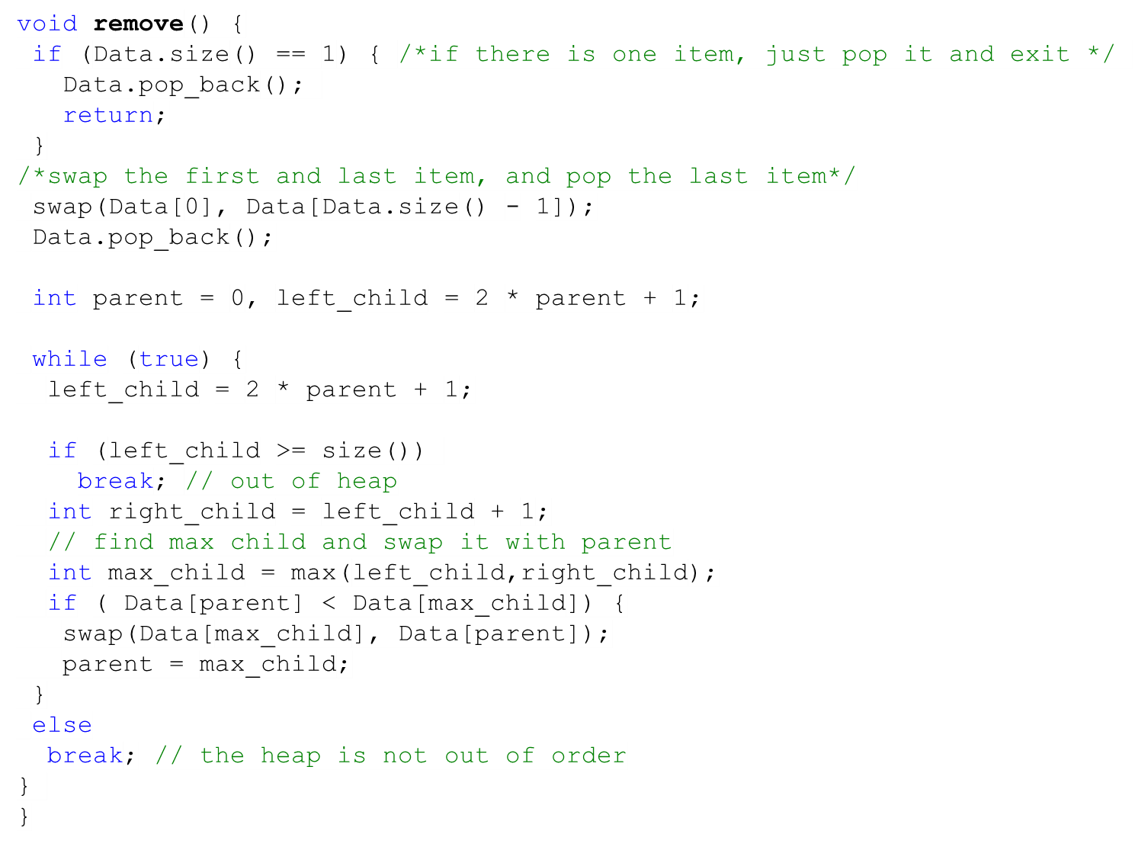
Removal from a heap (Code)
80
66
89
66
80
74
74
80
66
6
66
80
Max Child
Max Child
74
0 | 1 | 2 | 3 | 4 | 5 | 6 | 7 | 8 | 9 | 10 | 11 | 12 | 13
89 | 76 | 80 | 37 | 32 | 39 | 74 | 20 | 26 | 18 | 28 | 29 | 6 | 66
80
66
66
66

Slide 11
Task
Show the result of the heap in picture after removing number 89. Show the heap as a vector as well.
74
80
66
66
80
6
66
80

Slide 12
Solution
Show the result of the heap in picture after removing number 80. Show the heap as a vector as well.
76
37
26
6
66
80
66
80
0 | 1 | 2 | 3 | 4 | 5 | 6 | 7 | 8 | 9 | 10 | 11
76 | 37 | 74 | 26 | 32 | 39 | 66 | 20 | 6 | 18 | 28 | 29

Slide 13




Performance of Heaps
The remove algorithm traces a path from the root to a leaf node.
The insert algorithm traces a path from a leaf node to the root.
They both require h steps where h is height.
Largest Heap
Smallest Heap
Hence, both insert and remove are O(log n)

Slide 14
Heap Sort
Is O (n log n), but doesn’t require extra space like merge sort.
Algorithm
● Build heap starting from unsorted array
● While the heap is not empty
  ● Remove the first item from the heap:
    ● Swap it with the last item
  ● Restore heapness

Slide 15
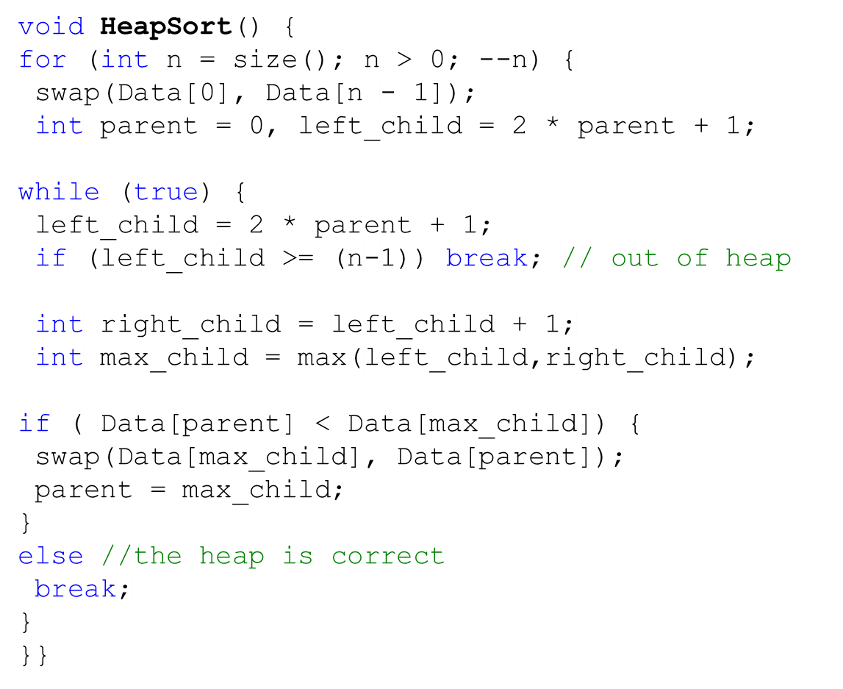
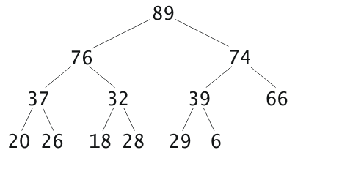
Heap Sort (Source Code)
74
76
29
6
37
6
29
66
26
6
29
6
76
89
74
29
6
76
76
0 | 1 | 2 | 3 | 4 | 5 | 6 | 7 | 8 | 9 | 10 | 11 | 12
89 | 76 | 74 | 37 | 32 | 39 | 66 | 20 | 26 | 18 | 28 | 29 | 6
37
89
6
66
26
29
6
29
6

Slide 16
Heap Sort Performance Analysis
Inserting and removing are O(log n)
Building a heap is: O (log 1) + O (log 2) + … + O (log (n-1)) + O (log n)
Total building cost is: O(n log n)
Shrinking a heap is: O (log n) + O (log (n-1)) + … + O (log 2) + O (log 1)
Total shrinking cost is: O(n log n)
Total cost is: O(n log n)

